Slide 1
Year 5 | Week 11 | Day 1

Slide 2
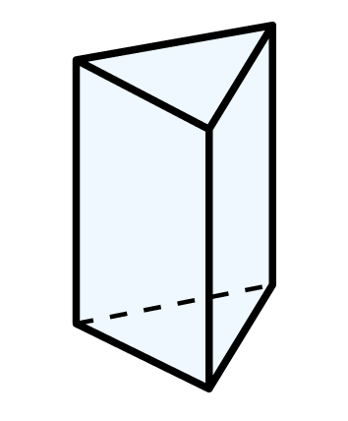
Year 5 | Week 11 | Day 2

Slide 3
Year 5 | Week 11 | Day 3

Slide 4
Year 5 | Week 11 | Day 4

Slide 5
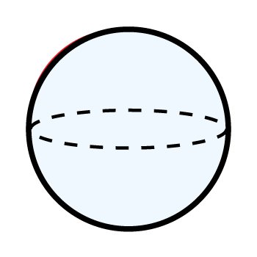
Year 5 | Week 11 | Day 5

